Slide 1
Deep Learning based Cpp2Pseudo Project
2023-1 CMD, AI
전은지, 박정민

Slide 2
For what?
C++ code to Pseudo code
Best C++ converter with trained models

Slide 3
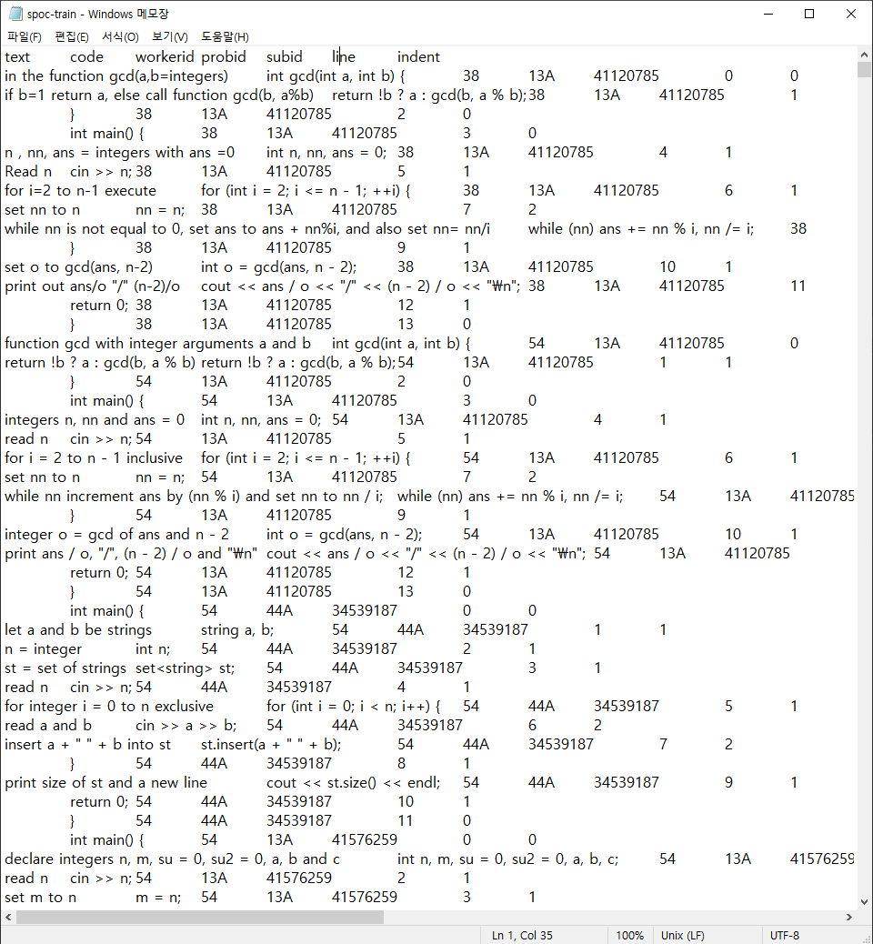
How to train?
Dataset : spoc-train.tsv
> C++ & Pseudo code & line & indent
Tokenize code with BERT
Tokenize text(Pseudo) with GPT

Slide 4
2 Transformers?
Transformer | BERT | GPT
Transformer block | Encoder block | Decoder block
Attention 방향 | Bi-directional | Uni-directional
문장 생성 활용 여부 | 직접 생성 불가능 | 문장 생성 가능

Slide 5
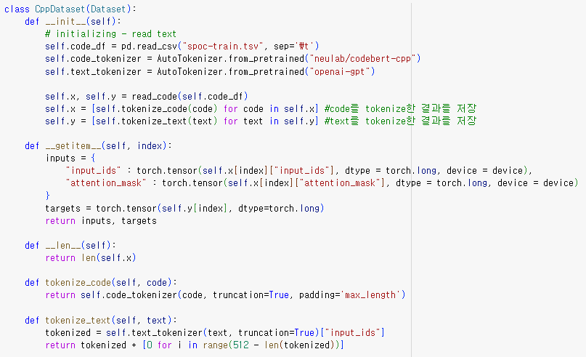
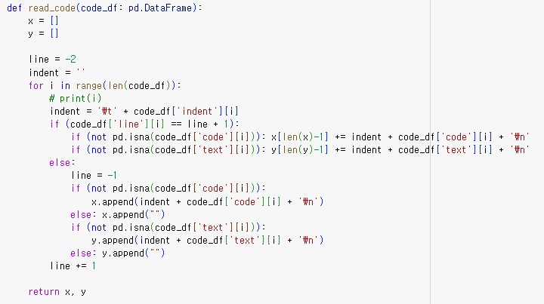

Slide 6
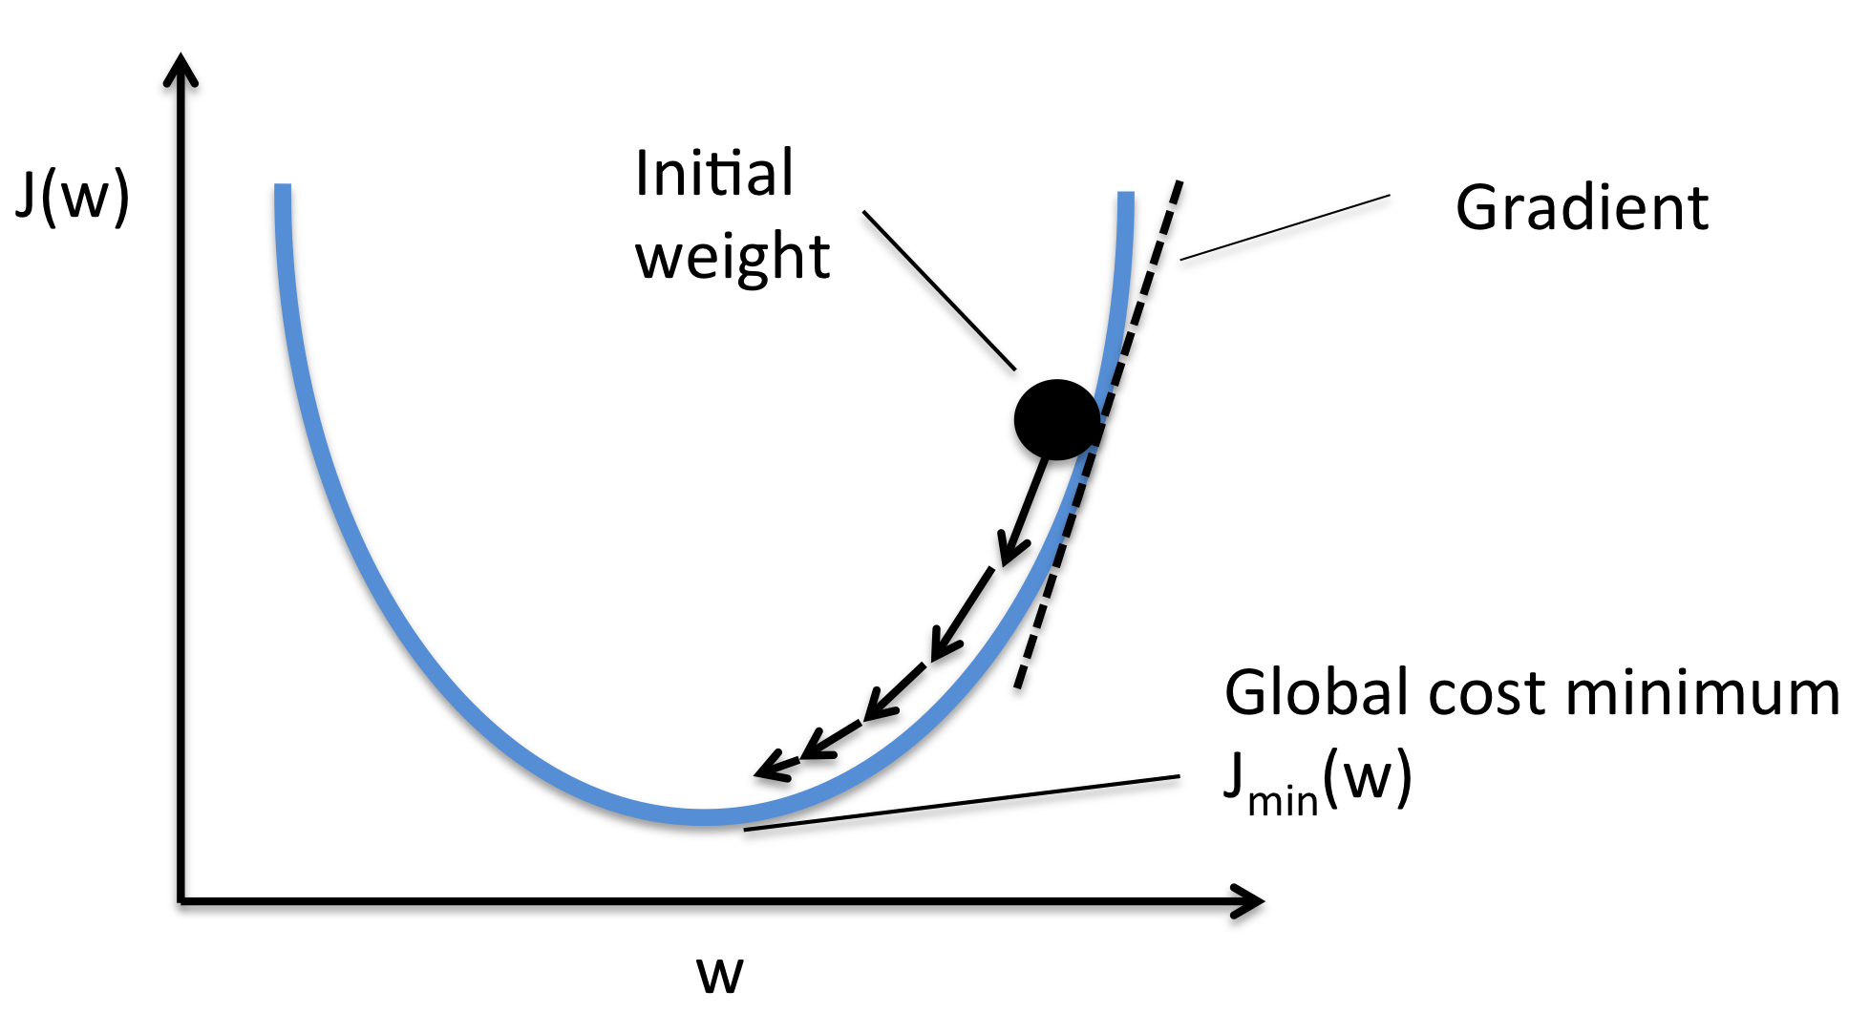
Optimizer & Loss Function
Optimizer : AdamW – based on Adam Algorithm, Gradient Descent optimization
Loss Function : SmoothL1Loss – Minimize difference btw predicted & actual values

Slide 7
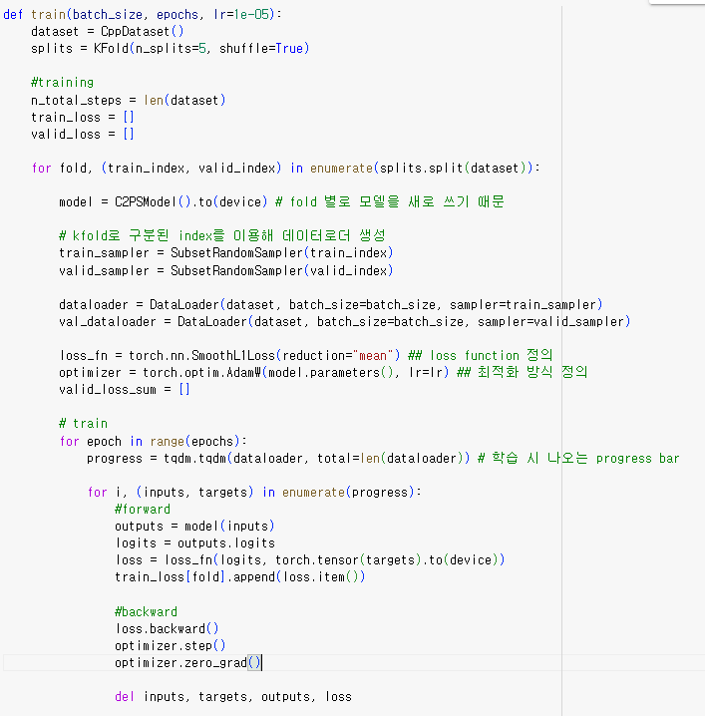
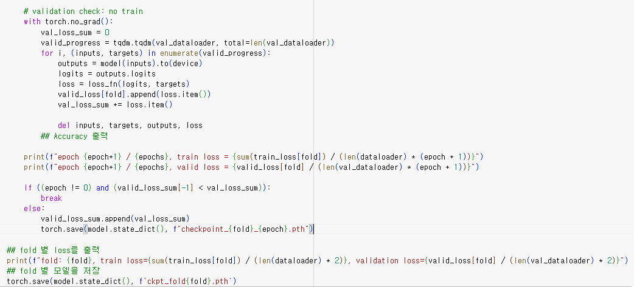

Slide 8
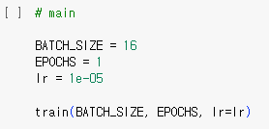
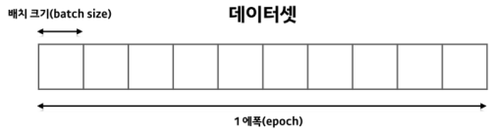

Training Process
Batch Size : Number of Data involved in Batch(The bigger, the faster, lower accuracy)
> Batch Size 16 for faster training
Epochs : 10, Normally used Epochs during Fine Tuning
Learning Rate : 1e-5(${10}^{−5}$)
> Based on C2PSModel() output

Slide 9
Goals & Expectations
Training Failed due to RAM issue..
Tokenized C++ & Pseudo > Well Trained, Elaborate Translator
Not only C++?!
> ex) Python, C, Java, etc… to Pseudo

Slide 10
Thank You!

